Slide 1




TRAVELING SALESMAN PROBLEM

Slide 2
GROUP MEMBER
Abanoub Amir George
Mazen Ahmed Mohamed
Mohamed Alaa Mohamed
Mohamed Ahmed Khadre
Mahmoud Abdelghany Rabea
Ahmed Atef Elpery
Ahmed Kamel Hassanin
Ahmed Mohamed Ahmed
Ahmed Mohamed Ebrahem

Slide 3

INTRODUCTION
What is the Traveling Salesman Problem (TSP)?
A classic algorithmic problem in computer science.
Objective: Find the shortest possible route that visits each city exactly once and returns to the starting point.

Slide 4

PROJECT GOALS
🎯 Main Objectives:
Develop a C++ application with a user-friendly Qt GUI.
Solve the Traveling Salesman Problem for real-world cities in Egypt.
Help users understand and compare different algorithmic approaches.
✅ Allow users to add/edit/delete cities with latitude and longitude.
✅ Implement and integrate three TSP algorithms:
✅ Visualize cities and paths on a 2D interactive map.
✅ Show animated route drawing for each algorithm.
✅ Display total route distance accurately using the Haversine formula

Slide 5

PROCESS
1. Requirement Analysis
Gathered functional and non-functional needs
Defined inputs, outputs, and performance expectations
2. Algorithm Research & Selection
Studied Brute Force, Greedy, and Held-Karp methods
Chose algorithms balancing accuracy and performance
3. Design & Architecture
Designed modular system with clear separation of GUI, logic, and data
Planned GUI layout with Qt framework
4. Implementation
Developed algorithms in C++
Built GUI with Qt for city management and visualization
Integrated distance calculation using Haversine formula
5. Testing & Visualization
Tested algorithms with real Egyptian city data
Added animation to display route finding step-by-step
6. Documentation & Presentation
Prepared final report and presentation materials

Slide 6

ANALYSIS
Problem Understanding
TSP is NP-hard — exact solutions become computationally expensive as cities increase.
Real-world application requires accurate distance calculation on Earth's surface.
Key Considerations
Need for precise distance measurement using Haversine formula (accounts for Earth's curvature).
Trade-off between algorithm accuracy and runtime performance.
User interaction: adding/editing cities and selecting algorithms easily.

Slide 7
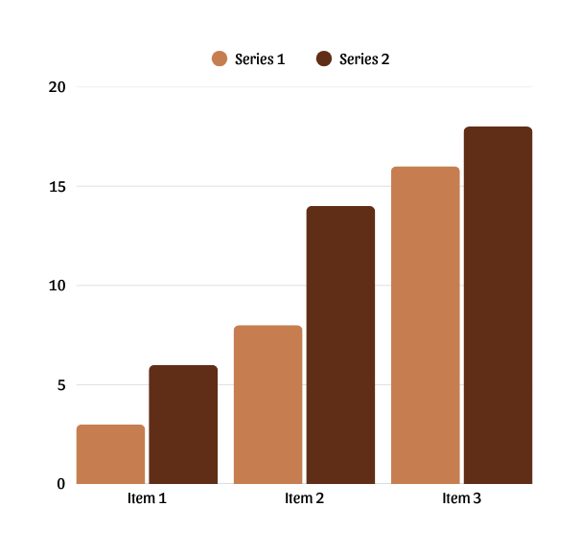
ANALYSIS
Algorithm Suitability
Brute Force: Guaranteed optimal but slow for >10 cities.
Dynamic Programming (Held-Karp): Optimal and faster than brute force but still exponential.
Greedy: Fast but approximate; good for quick estimates.
Expected Outcomes
Efficiently solve small-to-medium sized city sets.
Provide intuitive visualization for better understanding.

Slide 8
RESULT
Brute Force: Optimal routes for small city sets; slow for larger ones.
Dynamic Programming: Efficient exact solutions for medium city sets.
Greedy: Fast, good approximations, not always optimal.
Accurate distance calculation with Haversine formula.
Interactive GUI with city management and animated route visualization.
Real-time updates of route and total distance.

Slide 9
CONCLUSION
Successfully developed a user-friendly TSP solver for Egyptian cities.
Implemented and compared three algorithms: Brute Force, Dynamic Programming, and Greedy.
Accurate distance calculation and clear route visualization.
Modular design allows easy future improvements.
Useful tool for learning and demonstrating TSP concepts.

Slide 10
THANK YOU

